Slide 1
SDXML VT2024
Models and languages for semi-structured data and XML
XML-based languages
Usages of XML and SSD
nikos dimitrakas
nikos@dsv.su.se
08-161295
Corresponding reading
Chapter 1, 4, 16, 18 of the course book
Section 31.4 of Database Systems (Connolly, Begg) 6th edition (section 30.4 in 5th edition)

Slide 2
XML-based languages
Definition of structure
Definition of semantics
XML basic rules
  Alphabet, Vocabulary
XML Schema (or DTD)
  Grammar, Syntax
XML Schema annotations (for humans)
  Semantics, Meaning

Slide 3
XML-based languages - examples
DC (Dublin Core)
MathML
CML (Chemical Markup Language)
RecipeML
ODF (Open Document Format)
OOXML (Open Office XML)
SVG (Scalable Vector Graphics)
WSDL (Web Services Description Language)
RSS (Really Simple Syndication)
RDF and RDFS (Resource Description Framework)
  RDF XML (RDF is much more than an XML-based language)
And many, many more

Slide 4
DC (Dublin Core)
Catalog metadata for books, articles, etc.
  Close relation to RDF
15 elements
  Title, Subject, Description, Type, Source, Relation, Coverage, Creator, Publisher, Contributor, Rights, Date, Format, Identifier, Language
Many more metadata terms
  Redefine the 15 elements
<book xmlns:dc="http://purl.org/dc/elements/1.1/">
<dc:title>The blue sea</dc:title>
<dc:description>Book with pictures about the ocean</dc:description>
<dc:publisher>Great Books Publishing</dc:publisher>
<!-- etc -->
</book>

Slide 5
MathML
Representation of mathematical equations
  Visual representation
  Semantic representation
x³+5
<math>
<mrow>
<msup>
<mi>x</mi>
<mn>3</mn>
</msup>
<mo>+</mo>
<mn>5</mn>
</mrow>
</math>
<math>
<apply>
<plus />
<apply>
<power />
<ci>x</ci>
<cn>3</cn>
</apply>
<cn>5</cn>
</apply>
</math>

Slide 6
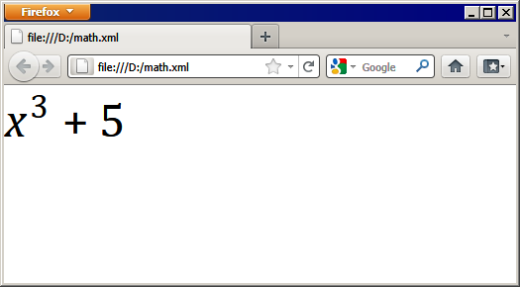
MathML
Built-in support in certain browsers:
<?xml version="1.0" encoding="ISO-8859-1"?>
<math xmlns="http://www.w3.org/1998/Math/MathML">
<mrow>
<msup>
<mi>x</mi>
<mn>3</mn>
</msup>
<mo>+</mo>
<mn>5</mn>
</mrow>
</math>

Slide 7
CML (Chemical Markup Language)
Representation of chemical formulas
  molecules, reactions, etc
Elements
  atom, atomParity, atomSet, atomType
  electron, molecule, particle
  action, reaction, reactant
  angle, bond, crystal, dimension
  formula, isotope, spectrum
  etc.
Namespace
  http://www.xml-cml.org/schema

Slide 8
RecipeML
Describes recipies
  ingredients
  process
Elements
  recipe
  ingredients and ing
  directions and step
<recipeml>
<recipe>
<head>
<title>Chocolate Milk</title>
</head>
<ingredients>
<ing>
<amt><qty>1</qty><unit>cup</unit></amt>
<item>milk</item>
</ing>
<ing>
<amt><qty>2</qty><unit>tsp.</unit></amt>
<item>chocolate powder</item>
</ing>
</ingredients>
<directions>
<step>Pour the milk in a cup</step>
<step>Add the chocolate powder</step>
<step>Mix until powder dissolves</step>
</directions>
</recipe>
</recipeml>

Slide 9
ODF (Open Document Format)
For representing
  documents
  spreadsheets
  presentations
  graphs, diagrams, tables
OASIS standard and ISO standard
Uses MathML
The latest version has a formal relationship to RDF and DC

Slide 10
OOXML (Open Office XML)
Microsoft's counterpart to ODF
  Became standard after much lobbying
Comprised of many smaller languages
  WordprocessingML
  SpreadsheetML
  PresentationML
  OfficeMathML
  DrawingML

Slide 11
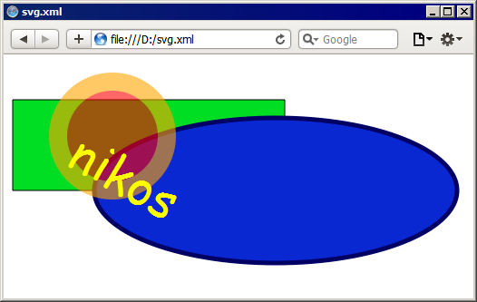
SVG (Scalable Vector Graphics)
Represents 2D graphics
Supports
  vector graphics
  images
  text
  interactivity
  animation
Supported in most web browsers
  Some may require a plugin
<svg width="100%" height="100%" version="1.1" xmlns="http://www.w3.org/2000/svg">
<rect x="10" y="50" width="300" height="100" style="fill:rgb(0,222,35); stroke-width:1; stroke:rgb(0,0,0)"/>
<ellipse cx="300" cy="150" rx="200" ry="80" style="fill:rgb(10,40,210); stroke:rgb(0,0,100); stroke-width:5"/>
<circle cx="120" cy="90" r="60" stroke="orange" stroke-width="20" fill="red" opacity="0.6"/>
<text x="120" y="70" font-family="Comic Sans MS" font-size="54" fill="yellow" transform="rotate(30)">nikos</text>
</svg>

Slide 12
WSDL (Web Services Description Language)
Used to describe Web Services
  defines data types
  defines calls (operations with input and output)
  defines details about protocols
Used together with SOAP
<?xml version="1.0" encoding="UTF-8"?>
<wsdl:definitions xmlns:wsdl="http://schemas.xmlsoap.org/wsdl/" xmlns:xsd="http://www.w3.org/2001/XMLSchema">
<wsdl:types>
<complexType name="DTCustomer">
<sequence><element name="customerName" nillable="true" type="xsd:string"/>
<element name="userName" nillable="true" type="xsd:string"/></sequence>
</complexType>
</wsdl:types>
<wsdl:message name="loginRequest">
<wsdl:part name="in0" type="xsd:string"/>
<wsdl:part name="in1" type="xsd:string"/>
</wsdl:message>
<wsdl:message name="loginResponse">
<wsdl:part name="loginReturn" type="DTCustomer"/>
</wsdl:message>
<wsdl:portType name="B2BService">
<wsdl:operation name="login" parameterOrder="in0 in1">
<wsdl:input message="loginRequest" name="loginRequest"/>
<wsdl:output message="loginResponse" name="loginResponse"/>
</wsdl:operation>
</wsdl:portType>
<wsdl:service name="B2BServiceService">
<wsdl:port name="B2BWebService">
<wsdlsoap:address location="http://iv1023.kth.se/services/B2BWebService"/>
</wsdl:port>
</wsdl:service>
</wsdl:definitions>

Slide 13
RSS (Really Simple Syndication)
Used mostly for news feeds, blogs, ads, etc.
Earlier "RDF Site Summary" with a relationship to RDF
AKA "Rich Site Summary"
Often combined with DC
<rss version="2.0">
<channel>
<link>http://www.cbsnews.com/</link>
<title>Breaking News: CBS News</title>
<item>
<title>Stocks turn lower as optimism about jobs fades</title>
<link>http://feeds.cbsnews.com/~r/CBSNewsMain/~3/WdSytMQjwds/main20088553.shtml</link>
<description>Day after worst single-day drop since 2008, Dow jumps on strong hiring report - then quickly loses gains</description>
<pubDate>Fri, 05 Aug 2011 07:47:45 EDT</pubDate>
</item>
<item>
<title>Syrian troops fire on defiant protesters; 8 dead</title>
<link>http://feeds.cbsnews.com/~r/CBSNewsMain/~3/5eg3GhnUoG0/main20088559.shtml</link>
<description>Regime's security forces open fire on tens of thousands across nation calling for downfall of President Bashar Assad</description>
<pubDate>Fri, 05 Aug 2011 07:58:53 EDT</pubDate>
</item>
</channel>
</rss>

Slide 14
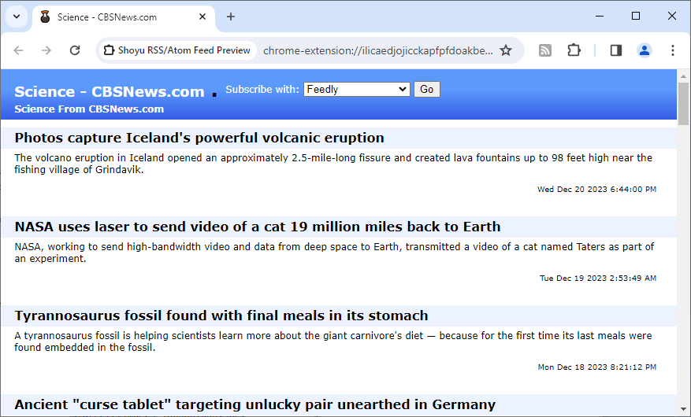
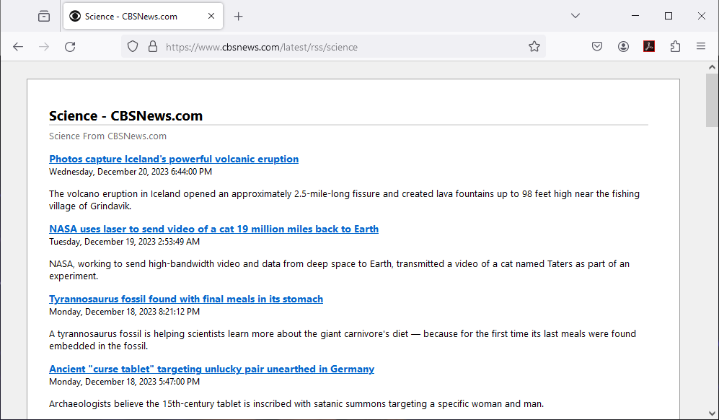
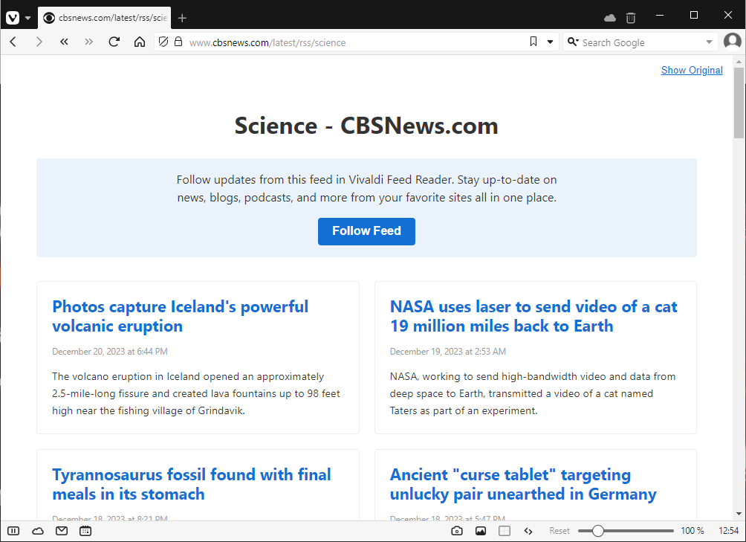
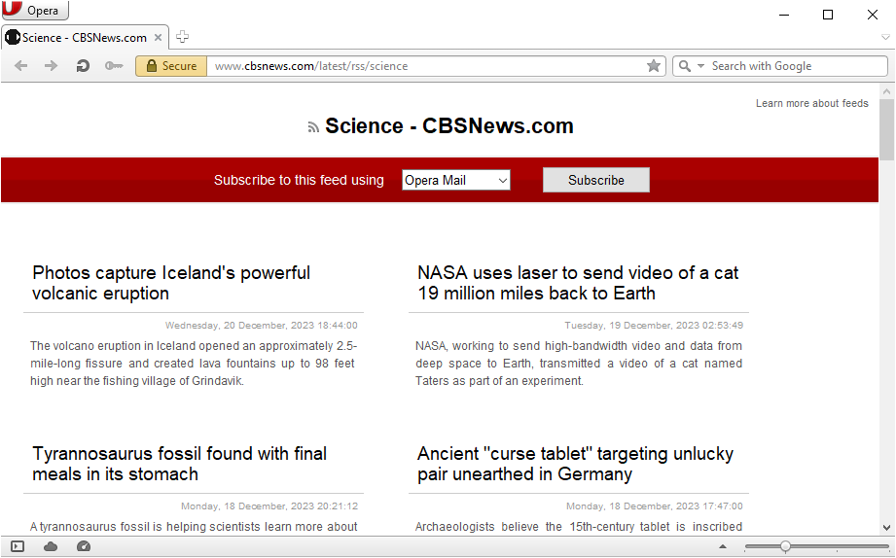
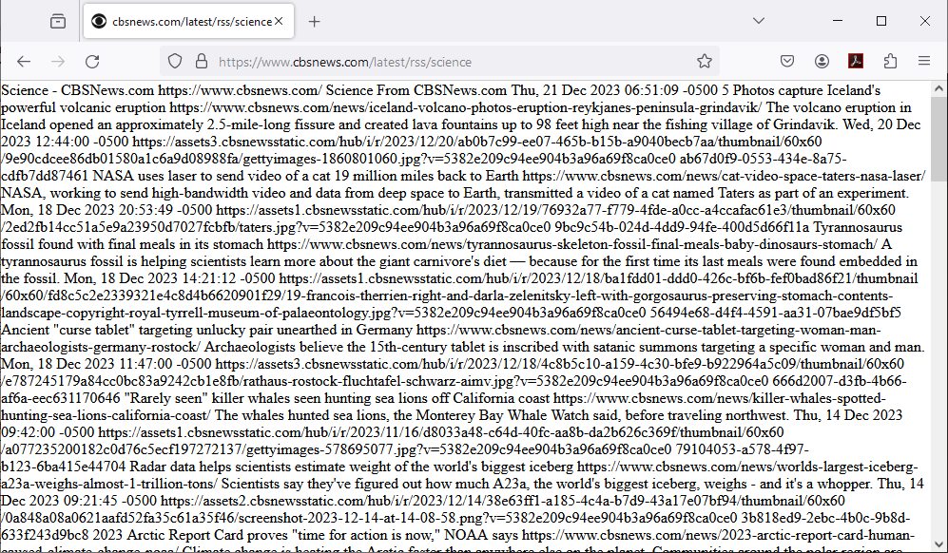
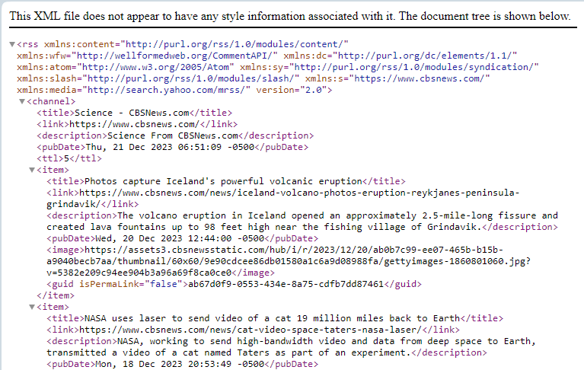
RSS (Really Simple Syndication)
Built-in support in some browsers
  Example: https://www.cbsnews.com/latest/rss/science

Slide 15
RDF (Resource Description Framework)
Used to describe resources (anything in the universe)
  Identify a resource uniquely with a URI
  State something about the resource
RDF Statements
  A subject (the resource)
  A predicate (a property, similar to attributes in other terminologies)
  An object (the value, may be a resource)
RDF representations
  Graph
  XML (so "RDF/XML" is an XML-based language)
RDF Schema (RDFS)
  For defining rules
  Also an XML-based language
  An RDFS document is an RDF document
Notes:
Uniform Resource Identifier (ASCII)
Internationalized Resource Identifier (Unicode)

Slide 16
RDF/XML example
<rdf:RDF xmlns:rdf="http://www.w3.org/1999/02/22-rdf-syntax-ns#"
xmlns:sdxml="sdxml/predicates/">
<rdf:Description about="sdxml/res/p1">
<sdxml:name>Maria</sdxml:name>
<sdxml:hasAsBoss rdf:resource="sdxml/res/p2" />
</rdf:Description>
<rdf:Description about="sdxml/res/p2">
<sdxml:name>Lisa</sdxml:name>
</rdf:Description>
<rdf:RDF>

Slide 17
RDF, DC and other languages
Everything can be considered to be a resource
  RSS channel, item
  MathML
  CML
  RecipeML
  ODF documents
All resources may have DC metadata
  An ODF document may have a dc:creator, dc:date
  An rss:channel and rss:item may have dc:date, dc:language, dc:title
  etc.

Slide 18
Open Data
Availability
  free to use
  in a standard format
  CSV
  XML
  JSON
  RDF

Slide 19
Usages of XML and JSON
Open data
  RDF
  ODF
  OOXML
Metadata in files
APIs (Application Programming Interface)
  XML
  JSON
Protocols
Configurations
  Programming languages
  Software
Data transfer
  QTI (Question & Test Interoperability) (supports MathML)

Slide 20
Metadata in Files
PDF
  Adobe metadata with RDF and DC (XML)
Try to open a pdf in Notepad++

Slide 21
APIs
Input and output as
  JSON
  XML
REST (Representational State Transfer)
  Combining HTTP with XML or JSON
  GET, POST, PUT, DELETE
SOAP (Simple Object Access Protocol)
  Sending messages as XML
  Built-in support for error handling

Slide 22
REST API - Example
GET
JSON as response
GET HTTP://sdxml.dsv.su.se/api/course/345 accept: application/json
Response:
HTTP 200 (success, found it) (404 if not found, and no body)
Body
{
"id" : 245, "code" : "DB101",
"nameEN" : "Database methodology",
"nameSV" : "Databasmetodik"
}

Slide 23
REST API - Example
GET
XML as response
GET HTTP://sdxml.dsv.su.se/api/course/345 accept: application/xml
Response:
HTTP 200 (success, found it) (404 if not found, and no body)
Body
<course>
<id>245</id>
<code>DB101</code>
<nameEN>Database methodology</nameEN>
<nameSV>Databasmetodik</nameSV>
</course>

Slide 24
REST API - Example
PUT (update)
XML in the request body
PUT HTTP://sdxml.dsv.su.se/api/course/345
Content-Type: application/xml
Body
<course>
<id>245</id>
<code>DB101</code>
<nameEN>Database methodology for beginners</nameEN>
<nameSV>Databasmetodik för nybörjare</nameSV>
</course>
Response: HTTP 200 (success) or other code

Slide 25
REST API - Example
POST (create)
With JSON in the request body
POST HTTP://sdxml.dsv.su.se/api/course
Content-Type: application/json
Body
{
"code" : "SDXML",
"nameEN" : "Semi-structured data and XML",
"nameSV" : "Semistrukturerade data och XML"
}
Response: HTTP 200 (success) or other code
Perhaps more as Body or Header

Slide 26
SOAP Message - Example
<soap:Envelope xmlns:soap="http://www.w3.org/2003/05/soap-envelope">
<soap:Body>
<getCourseInfoRequest>
<code>SDXML</code>
</getCourseRequest>
</soap:Body>
</soap:Envelope>
<soap:Envelope xmlns:soap="http://www.w3.org/2003/05/soap-envelope">
<soap:Body>
<getCourseInfoResponse>
<code>SDXML</code>
<nameEN>Semi-structured data and XML</nameEN>
<nameSV>Semistrukturerade data och XML</nameSV>
</getCourseResponse>
</soap:Body>
</soap:Envelope>

Slide 27
Configurations
Software like
  Web servers, FTP servers
    Tomcat
    Filezila
  Operating systems
    Windows
    Linux
  Desktop application
    VLC
    Notepad++
    NetBeans
    Firefox
Pretty much everywhere!

Slide 28
Programming
Java technologies
  Maven
  Spring
  Hibernate
  Jasper
  Struts
  Seam
  JavaFX (FXML)
  JUnit

Slide 29
Maven
Dependencies
Building
<?xml version="1.0" encoding="UTF-8"?>
<project xmlns="http://maven.apache.org/POM/4.0.0"
xmlns:xsi="http://www.w3.org/2001/XMLSchema-instance"
xsi:schemaLocation="http://maven.apache.org/POM/4.0.0
https://maven.apache.org/xsd/maven-4.0.0.xsd">
<dependencies>
…
</dependencies>
<build>
…
</build>
</project>

Slide 30
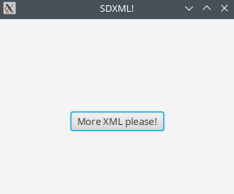
JavaFX with FXML
Java GUI
<?xml version="1.0" encoding="UTF-8"?>
<VBox alignment="CENTER" spacing="20.0" xmlns:fx="http://javafx.com/fxml"
fx:controller="sdxml.Controller">
<padding>
<Insets bottom="20.0" left="20.0" right="20.0" top="20.0"/>
</padding>
<Label fx:id="myText"/>
<Button text="More XML please!" onAction="#onButtonClick"/>
</VBox>

Slide 31
Spring
Beans
Injections
Transactions
Security
<?xml version="1.0" encoding="UTF-8"?>
<beans xmlns="http://www.springframework.org/schema/beans">
<bean id="myBean" class="sdxml.MyBean" >
<property name="name" value="XML"/>
<property name="status" value="5"/>
</bean>
</beans>

Slide 32
Hibernate
ORM (Object Relational Mapping)
Classes to tables and columns
<?xml version="1.0" encoding="UTF-8"?>
<!DOCTYPE hibernate-mapping>
<hibernate-mapping>
<class name="sdxml.Person" table="Pesron">
<id name="id" column="PersonID" type="int">
<generator class="native"/>
</id>
<property name="fname" column="Firstname" type="string" not-null="true"/>
<property name="lname" column="Lastname" type="string" not-null="true"/>
<property name="alive" column="Alive" type="boolean"/>
</class>
</hibernate-mapping>

Slide 33
Struts
Configuration of web application
  actions
  validations
  …
JSPs (Java server pages)
<?xml version="1.0" encoding="UTF-8" ?>
<struts>
<package name="sdxml" extends="default" namespace="/sdxml">
<action name="start" class="sdxml.StartAction" method="start">
<result name="success">great.jsp</result>
<result name="error">sorry.jsp</result>
</action>
</package>
</struts>

Slide 34
What to do next
Quiz about Semi-structured data, XML-based languages, usages (Quiz 4)

